Slide 1

Introducing HIF2025
(Isobel Mills & Alan Beswick)
Headingley Development Trust

Slide 2
To cover
Why shares
A brief reminder of our Community Shares Journey so far
What we have learned
What this means for HIF2025
Our video
Questions!

Slide 3
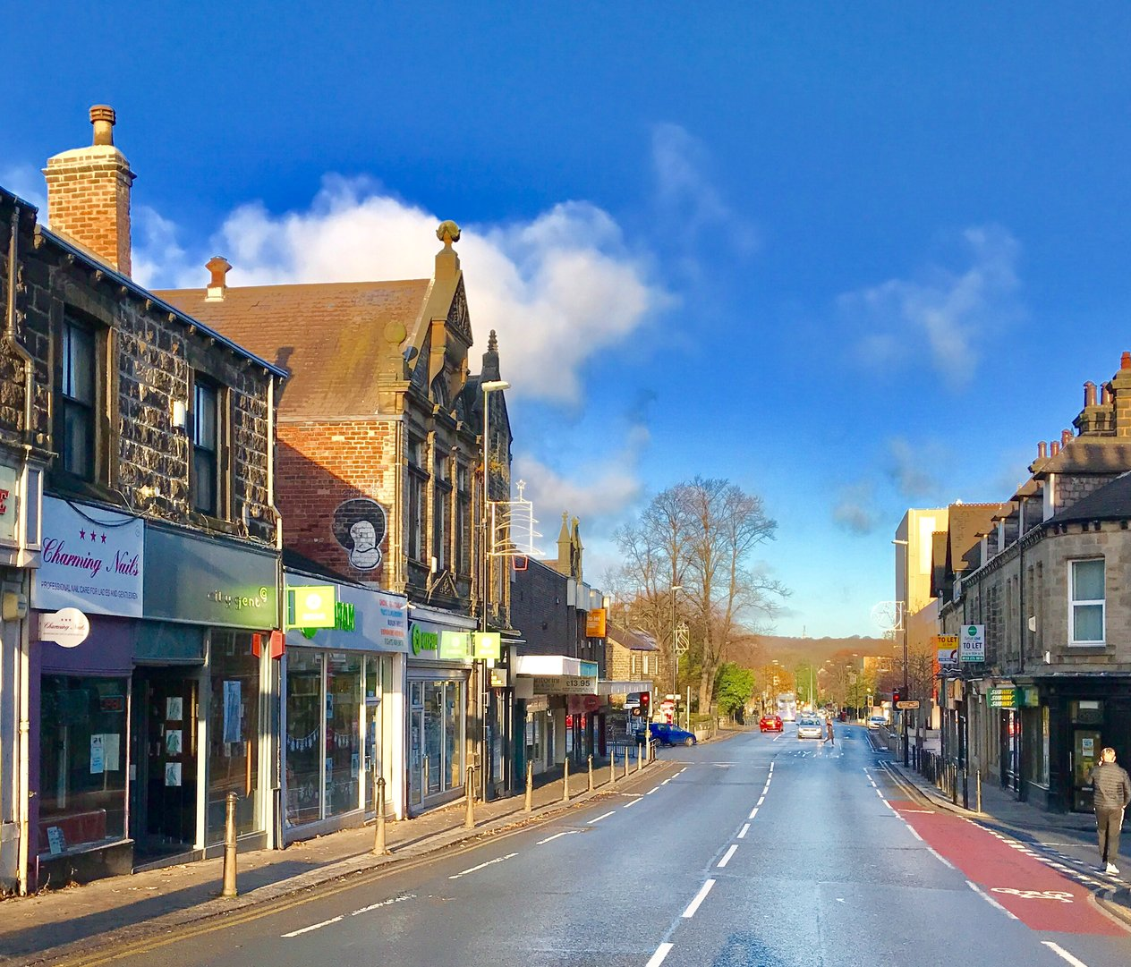
Why shares
HDT has always seen Community Shares as a practical way of furthering members’ ambitions
For a welcoming and neighbourly Headingley
With a good mix of housing
And a vibrant local economy
That thinks about the future

Slide 4
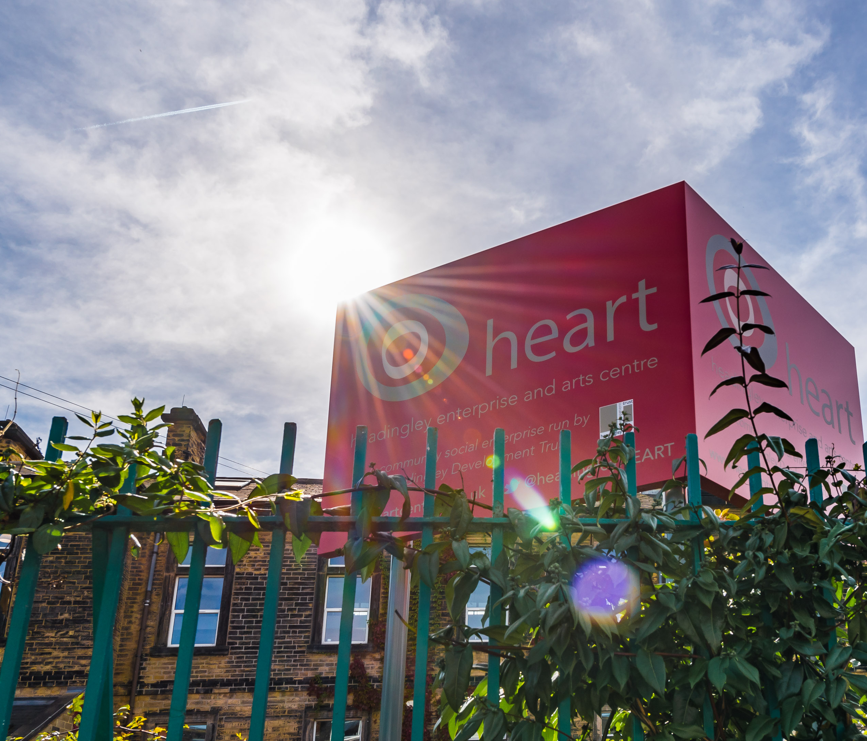
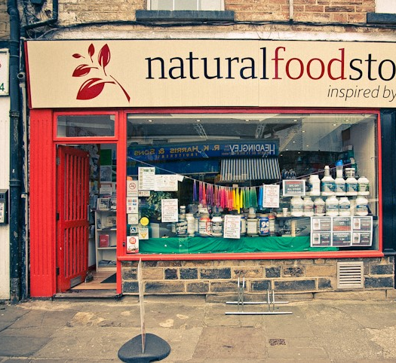
The Journey So far
In 2008 we raised £205k
£105,000 for development of HEART
£100,000 to support the purchase of the Natural Food Store
But offered no interest

Slide 5
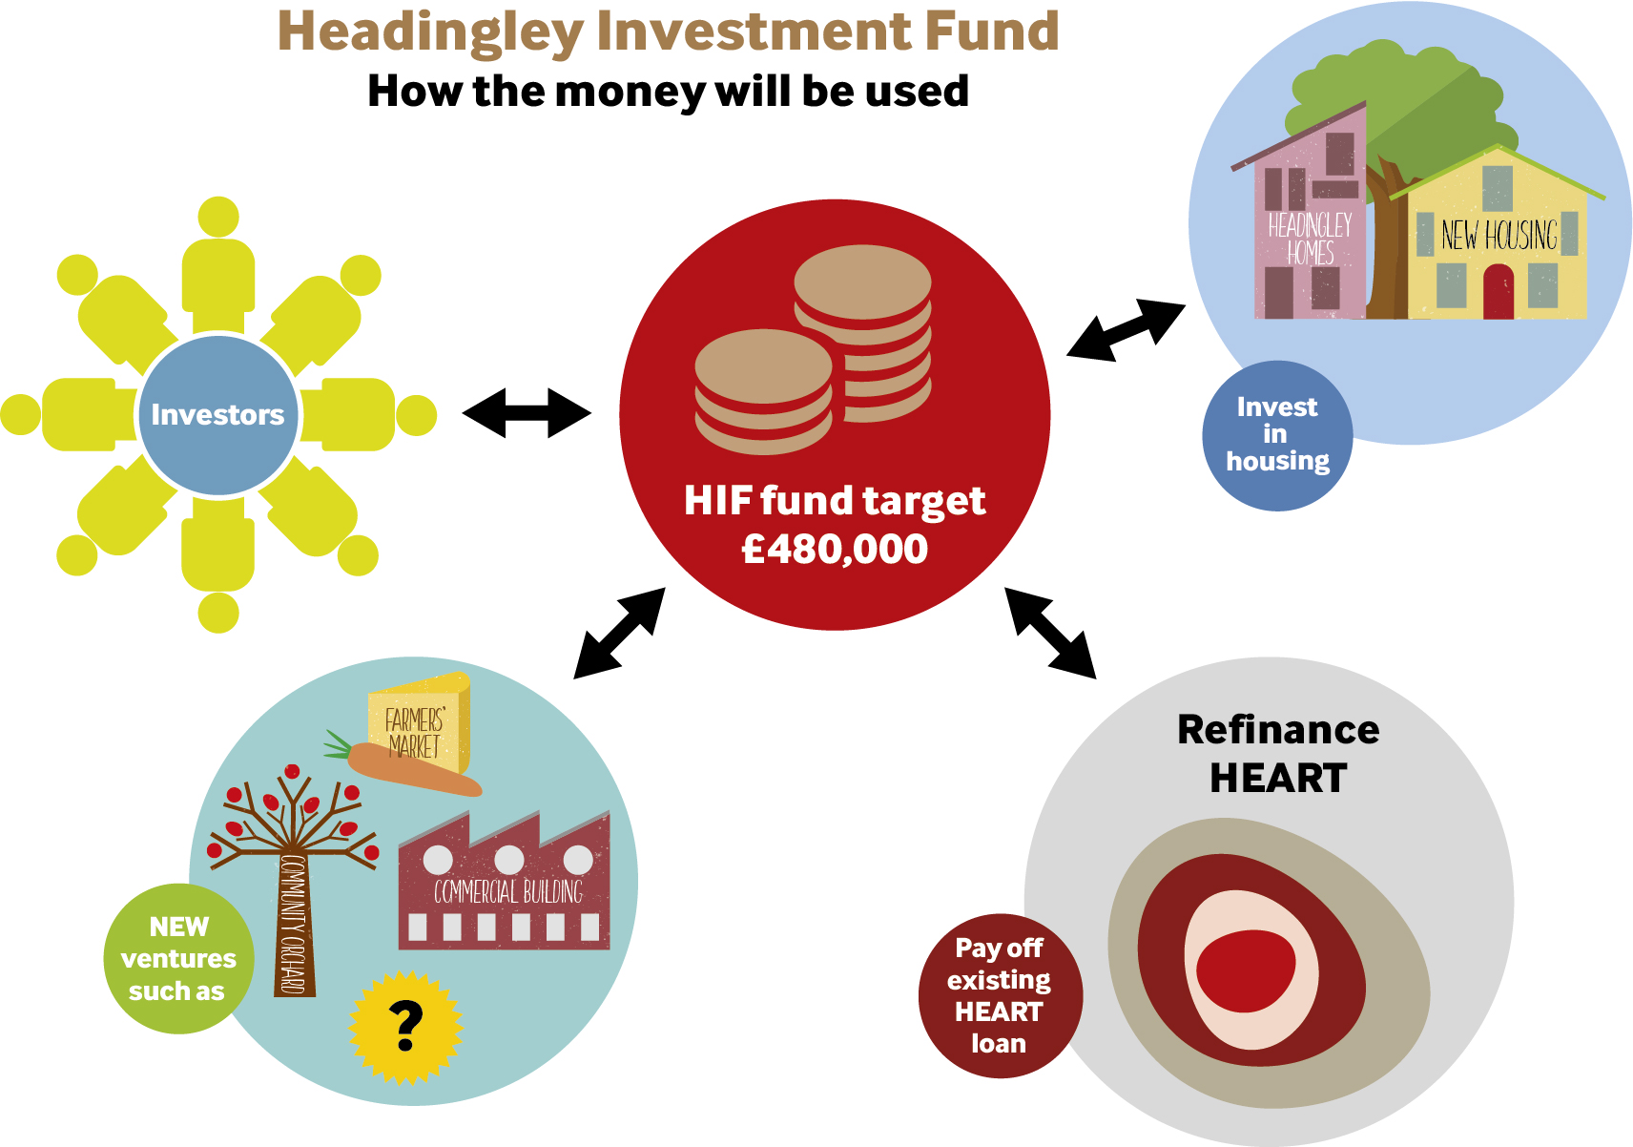
The Journey So far (continued)
In 2018 we raised £481k
Loan to HEART of £260k
Loan to buy and refurbish 50 Headingley Mount of £100k
£50k to buy the Greengrocer business, and then £105k to acquire THG and Butcher’s freehold at 50 North Lane.
We offered 2% interest – and charged projects 3%

Slide 6
Lessons learned (I)
When asked about Community Shares people said they were excited about:
Further investment in energy efficiency/greening of HDT’s current assets
Investment in these assets that increases their long-term viability
Projects that span, and bring together different generations and groups
Support for a brighter High Street (independent businesses, green/play space)
Support for smaller projects – a sort of community chest

Slide 7
Lessons learned (II)
Experience shows that:
Investors’ decisions and their trust are based on much, much more than a financial “return” …
… and many 2018 investors have foregone interest
It matters to people that their investment keeps our existing and treasured assets in great shape…
…but people are passionate about what could be, as well as what is.

Slide 8
What this means for HIF2025
The themes and the story…
Economic backdrop very different from 2018 – and 2008 even more so
Getting harder and harder to identify projects that fit with members’ vision and ambitions…
…and generate a return at pace
Many of the enterprises that inspire people and could transform are about “deep investment” – and payback over a longer time

Slide 9
What this means for HIF2025 (continued)
Need to balance doing what we know WILL generate a return – so swap out THG’s costly loan (as we did with HEART)
But also invest in other projects members would like us to take forward
Which is why we are proposing a mixed portfolio of investments…
…and a choice of interest rates

Slide 10
What this means for HIF2025 (continued)
The mixed portfolio:
A more affordable, local line of credit for The Headingley Greengrocer
Ensuring a viable future for the enterprises we already have
A “set-aside pot” – Reserves in Readiness.

Slide 11
Strand 1
A more affordable, local line of credit for The Headingley Greengrocer
Community Shares are ‘good giving and ‘better money’
So exactly as with HEART, we would use HIF2025 to “repatriate” the mortgage we have obtained for 50 North Lane, and put THG on a far more sustainable footing
This gives the business greater security and certainty – and sets it on the path of the next 125 years!

Slide 12
Strand 2
Ensuring a viable future for the enterprises we already have
Helping HEART thrive by investing in the playground, Pulse, Tiny Boo
Investing in the fabric of both HEART and THG: solar panels, better use of space, responding to customer needs
But have to recognise these projects will not generate a quick return, even if they reduced outgoings and draw in new and more footfall

Slide 13
Strand 3
Reserves in Readiness: Illustrative only
Small pot of say £30,000 enabling us as in 2018 to be nimble and opportunistic
Taking back the High Street and making every corner count
Low Carbon Homes Club
Seed money for smaller, start-up enterprises (but remember, this is only circa 10% of the overall ask)

Slide 14
Key Features of HIF2025
A choice of interest rates
0%
2%
4%

Slide 15
Other features
Minimum target is £100k – but aiming for £200k - £300k
  Applied for match funding from Booster Fund again (£50k)
We hope to encourage younger investors
  Shares can be bought on behalf of a minor
  Booster Fund will allow us to offer ‘subscription’ purchase (pay over 12 months)
  Minimum investment set at £100
Shares you buy will make you an HDT member
As with all shares offers, interest rates and withdrawals depend on financial position – and are at HDT discretion

Slide 16
Key Dates
31st March 2025 | Offer opens
30th June 2025 | Offer closes (option to extend 1 month)
1st July 2025 | Go Live Date Interest accrues
1st July 2028 | Investors select how interest is received First opportunity to give 3 months notice to withdraw funds
1st October 2028 and annually thereafter | Interest will be paid out/ reinvested or donated

Slide 17
Financial modelling and assurance
Projects will be charged investor rate + 1%
Modelled minimum and maximum fund targets and range of interest rates
Modelling shows HIF2025 can:
generate a small surplus,
make annual interest payments to members,
support a modest level of withdrawals over time
and will not be detrimental to HDT
The offer document and application form are easy to understand
You are provided with all the facts you need to make an informed decision
The facts are supported by the annual accounts and/or business plan for the Society
Nothing in the documents is purposely incorrect, confusing or misleading.

Slide 18
How to find out more and invest
Offer Document and Business Plan available from tonight on our website www.hdtleeds.org.uk/investment-fund
Come and talk to us
  This evening!
  At the Farmers’ Market - April, May and June markets
  On Zoom – date tbc
  Other events tbc
  Contact us at HIF2025@hdtleeds.org.uk
Invest via Crowdfunder https://www.crowdfunder.co.uk/p/hif25

Slide 19


Thank you for listening
Questions and reflections
HIF2025 Working Group
Alex Barrie Archie Wright-Beattie Alan Beswick John Chandler Hazel Dimsdale John Hall | Isobel Mills Sam Schwab Mike Sells Helen Seymour Matthew Spence

